Slide 1
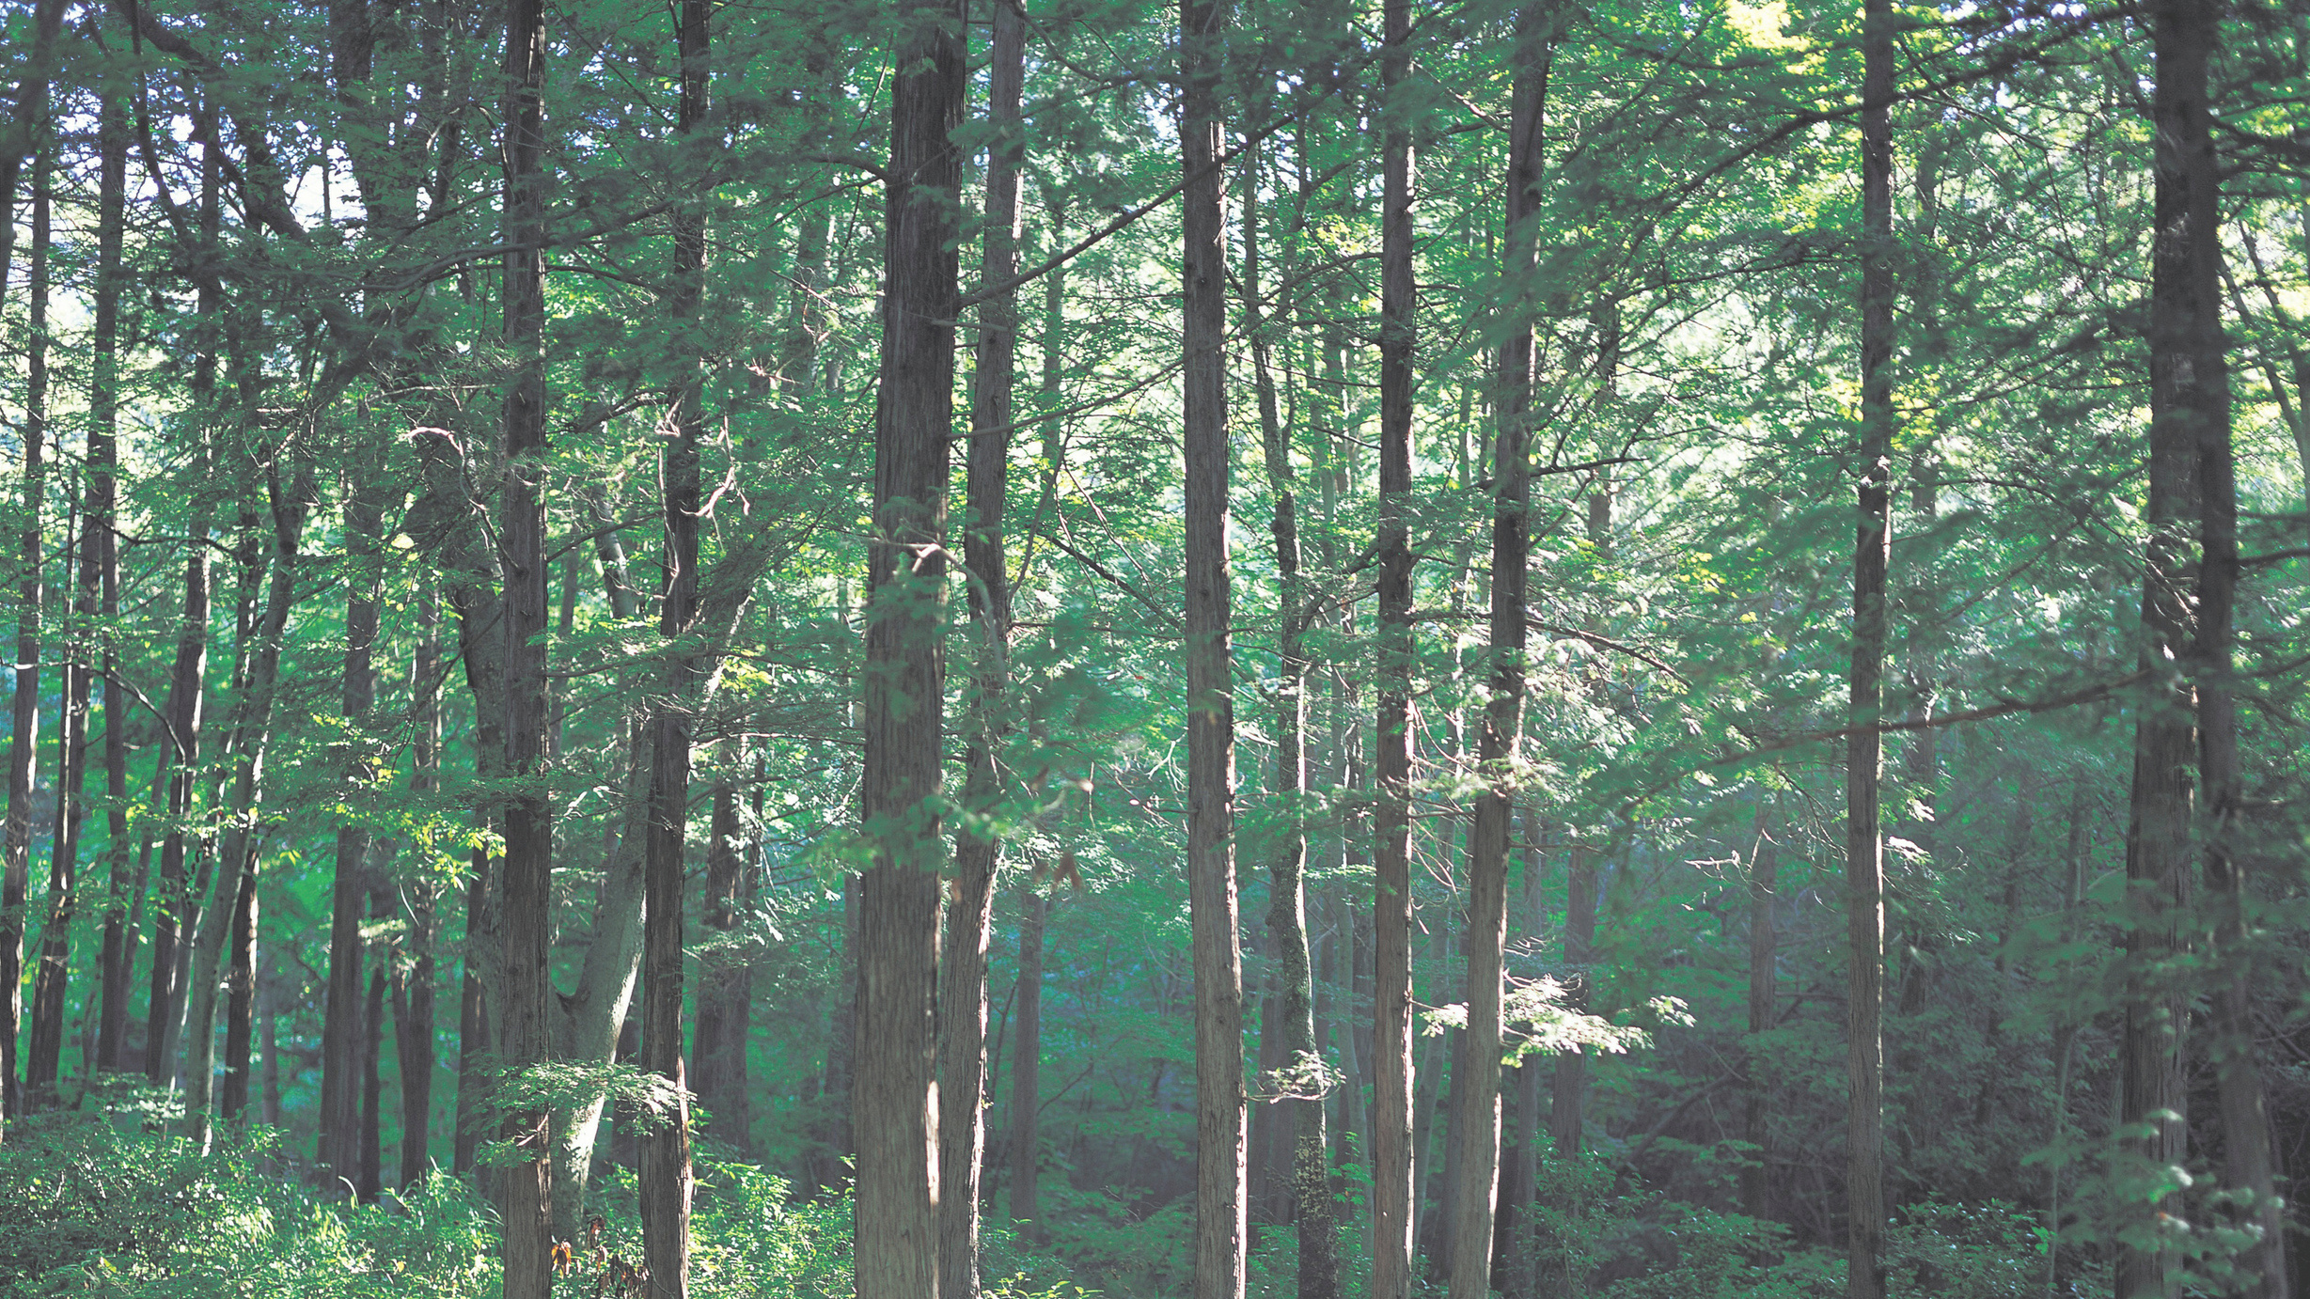




2023 ARIZONA NASA SPACE GRANT STATEWIDE SYMPOSIUM
USFWS INFO-SHEETS
Sofia Delgado

Slide 2
  Phenology: the timing of seasonal events of plants and animals. It includes things like when plants leaf out and flower, when birds migrate, and when insects emerge.
  used to understand climate change impacts on plants and animals, and useful for management and decision making
  - The USA-NPN was established in 2007 to be a network for phenology data collection, storage, and sharing. The USA-NPN works with agencies including the US Fish and Wildlife Service to make sure they have the phenology data they need to meet their mission to conserve wildlife and their habitats.
National Phenology Network
AN OVERVIEW

Slide 3
  Summarizing phenological changes that have already been documented on priority species and ecosystems for each USFWS region
  Translating the information into accessible language and visuals to assist managers to understand the shifts already occurring
Goals For This Project
A WONDERFUL HOBBY

Slide 4
Info sheets will include:
  projected climate changes, and how these changes may impact priority species and ecosystems
  ongoing phenology research or projects in the region
  USA-NPN data and data products that are relevant to the region
Goals For This Project
A WONDERFUL HOBBY

Slide 5
  Staff are tasked with conserving and protecting wildlife and their habitats, often focusing on particular priority species and ecosystems at individual National Wildlife Refuges.
  Management of these species is made more difficult under changing climate conditions. Climate projections are often vague and do not help refuges
Audience
A WONDERFUL HOBBY

Slide 6
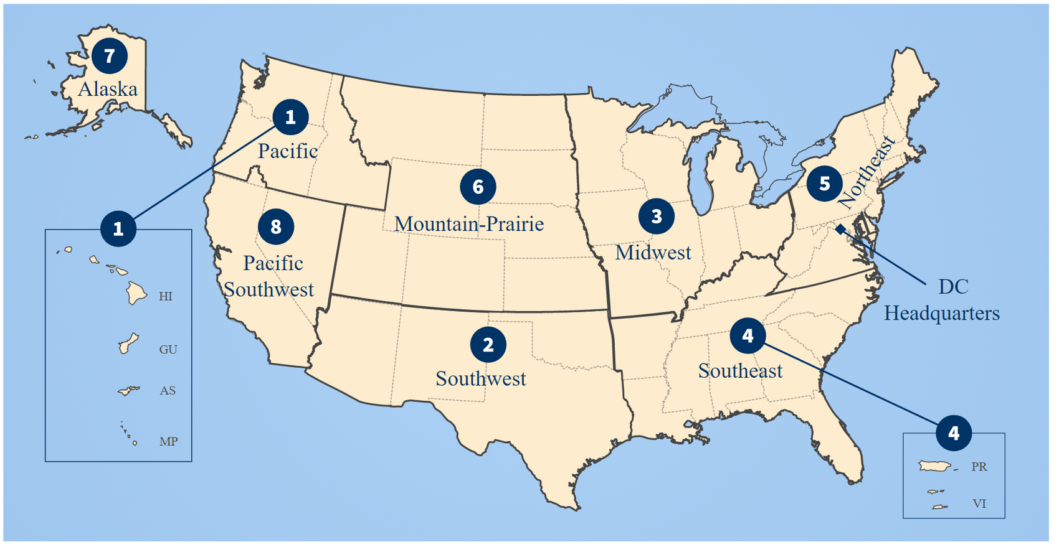

Slide 7

Process For Determining Priority Species

Slide 8


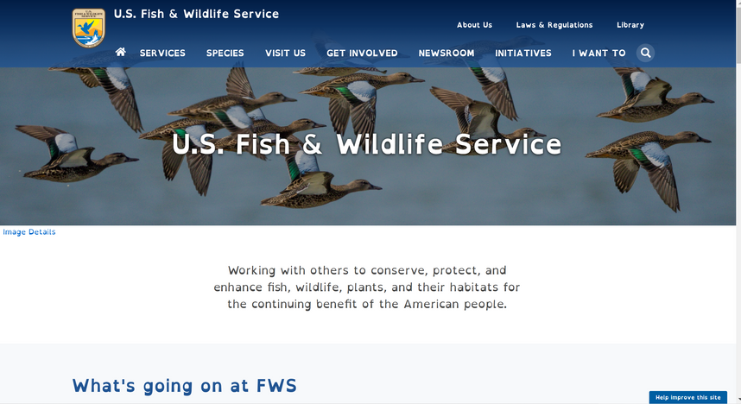
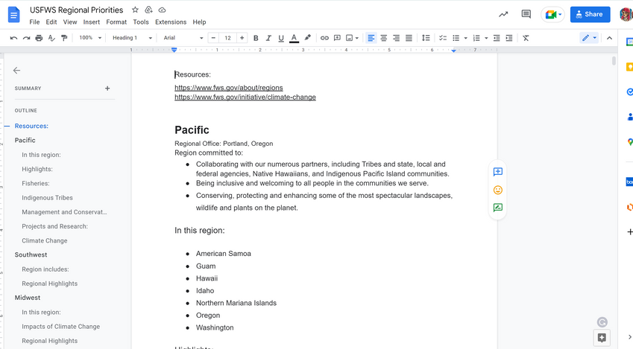

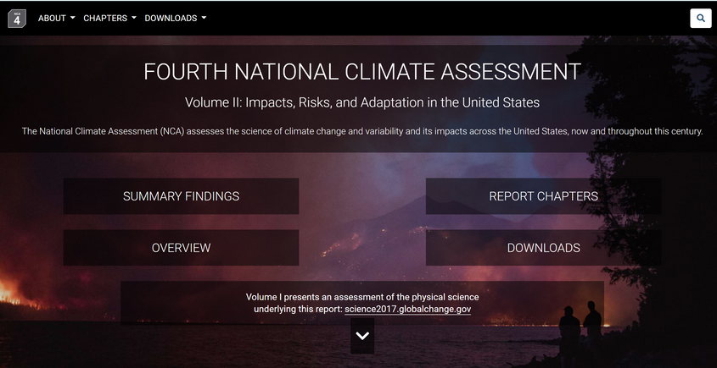

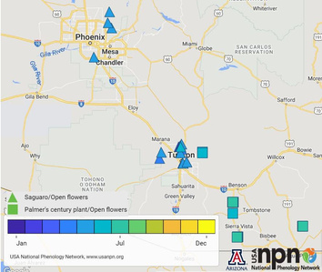
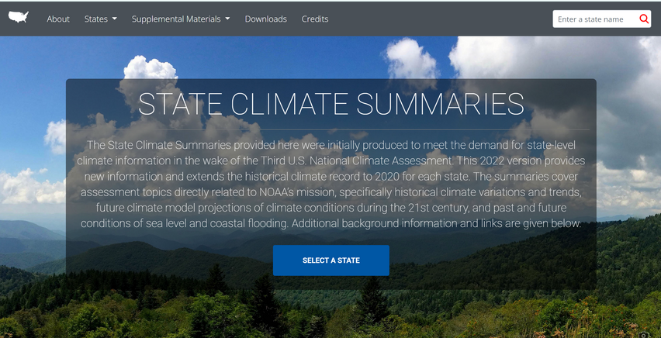
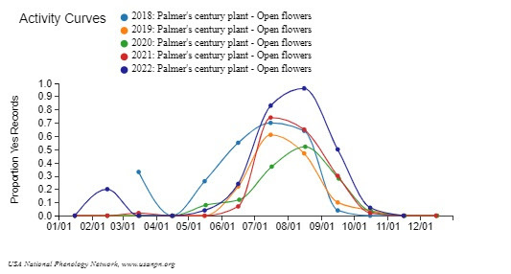
Find the phenological relevance and search for academic journals and articles
Look through the USFWS websites
Finally, look at relevant NPN data
Use NCA websites for climate data

Slide 9
Priorities by Region
PACIFIC
SOUTHEAST
MIDWEST
SOUTHWEST
Loggerhead sea turtles American crocodile
Moose Monarch butterflies and other pollinators Bats and white-nose syndrome
Lamprey seabirds coral endangered plants across the Hawaiian islands
Burrowing owls Mexican gray wolves Monarch butterfly

Slide 10
USFWS Regions
NORTHEAST
MOUNTAIN PRAIRIE
PACIFIC SOUTHWEST
ALASKA
Bats and white-nose syndrome Saltmarsh sparrow ecosystems that naturally withstand and recover from inland and coastal flooding
Wildflowers Migratory birds
Permafrost Seabirds Wetlands Spruce forest
Chinook Salmon Precipitation regime Wildfire

Slide 11
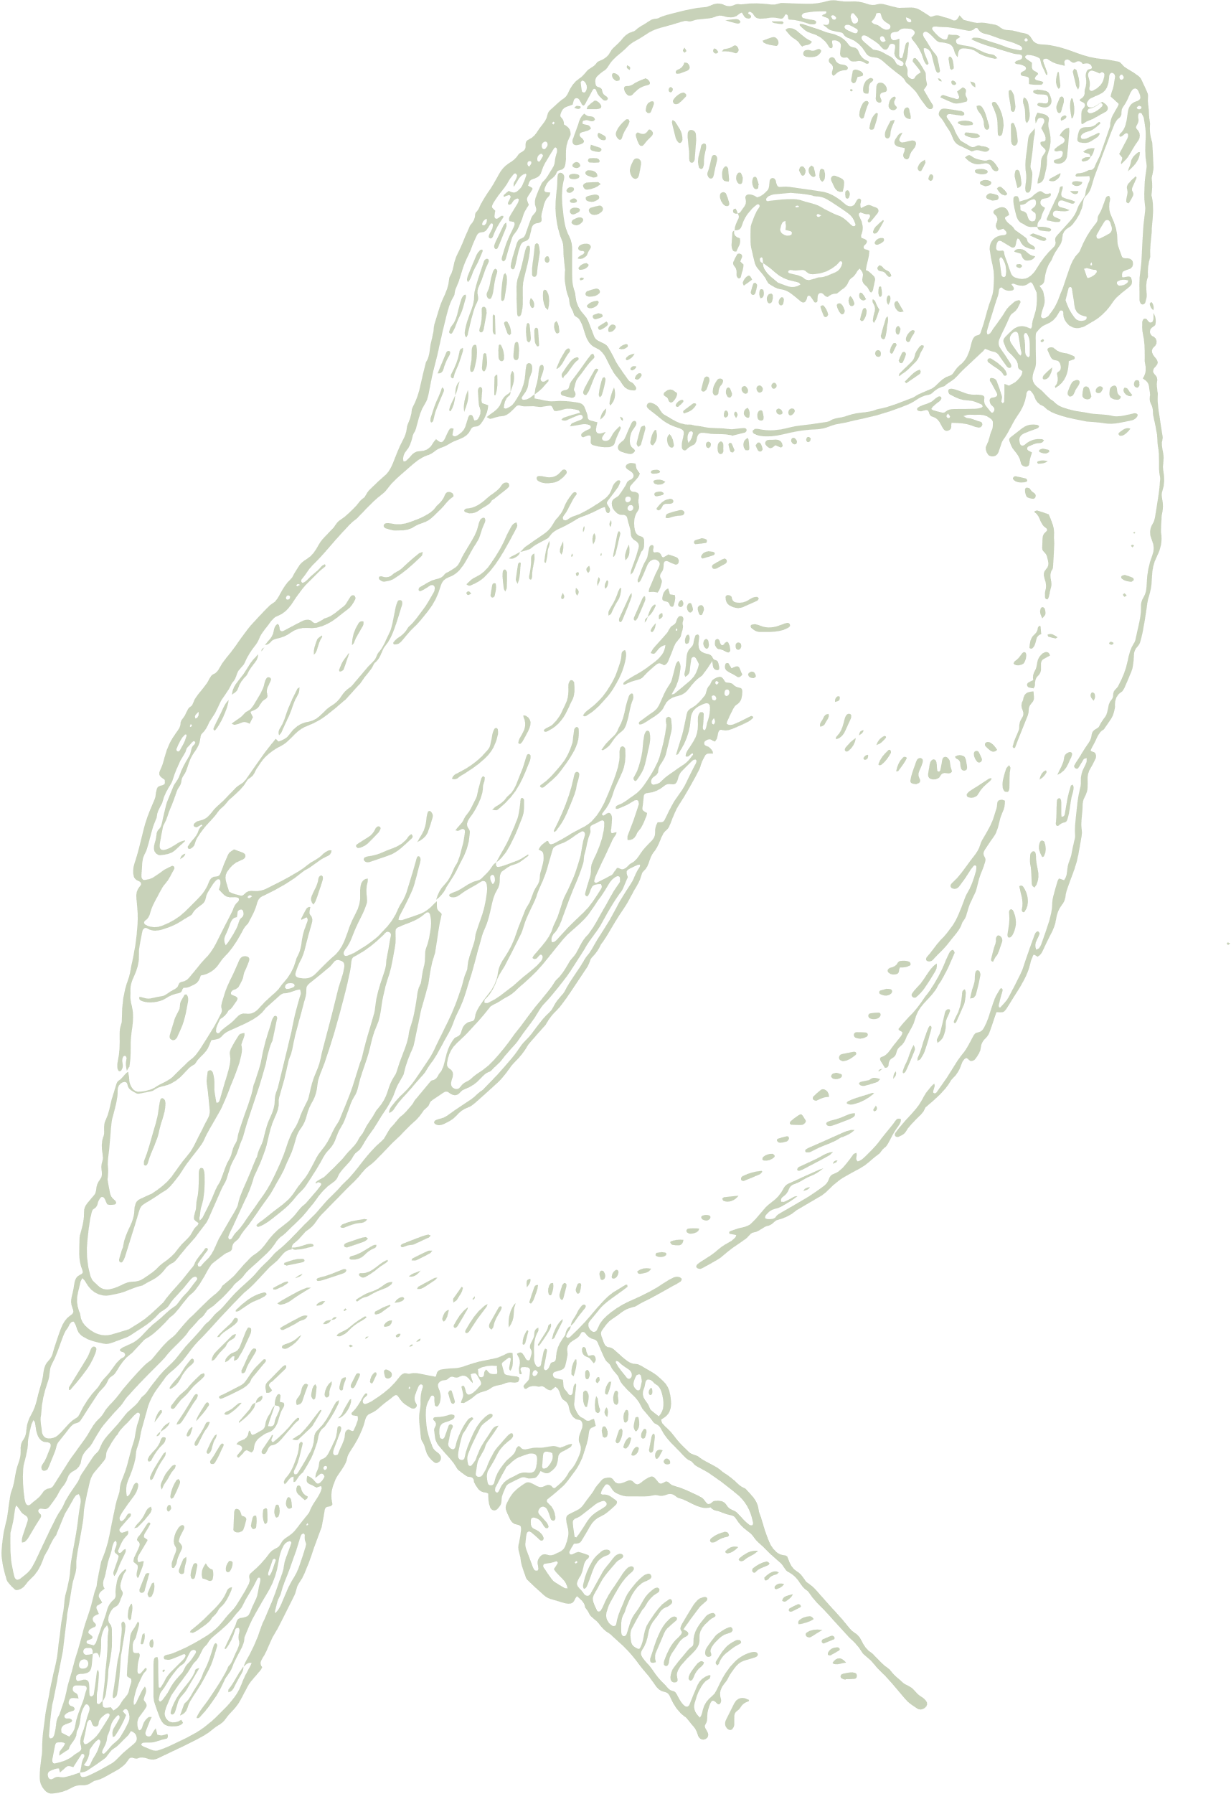
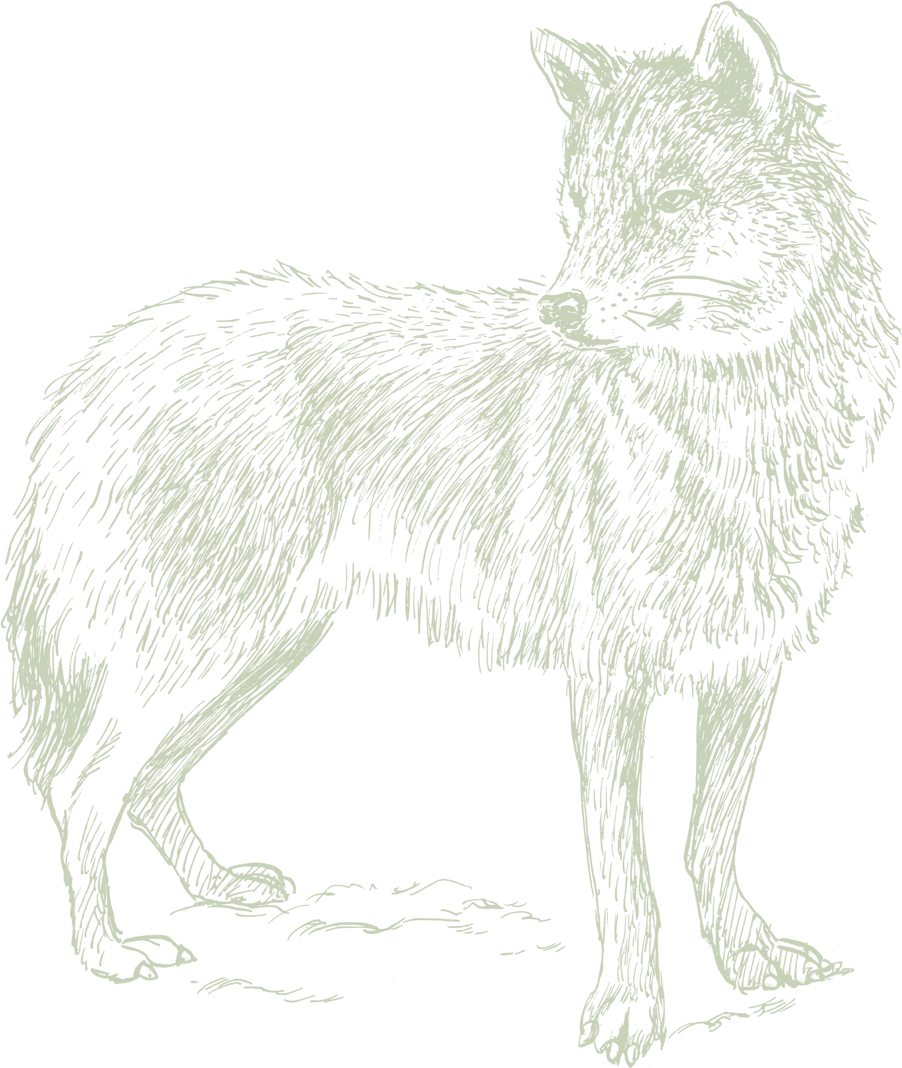
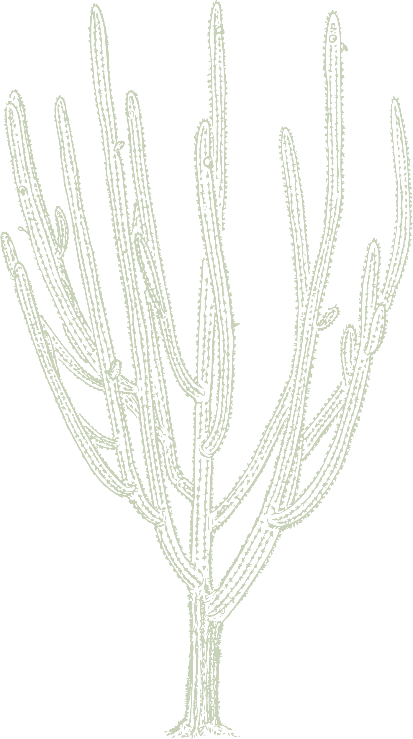
Changes Happening in Species and Ecosystems
In the Southwest:
  Burrowing Owls
    nesting influenced by drought
  Mexican Gray Wolves
    denning phenology

Slide 12

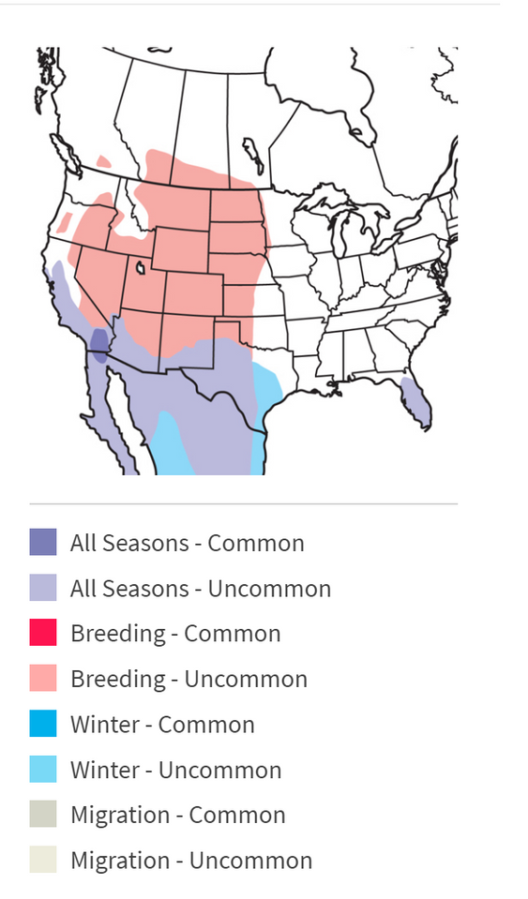
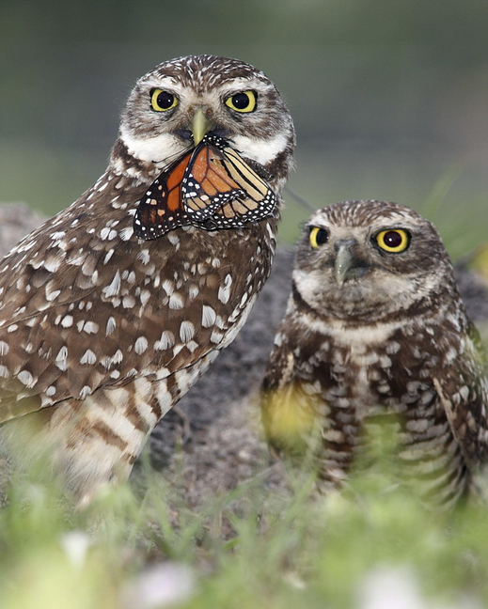
  Migration
    Birds in Northern regions migrate south
    Many birds in parts of the southwest may be permanent residents
Drought and Burrowing Owls

Slide 13




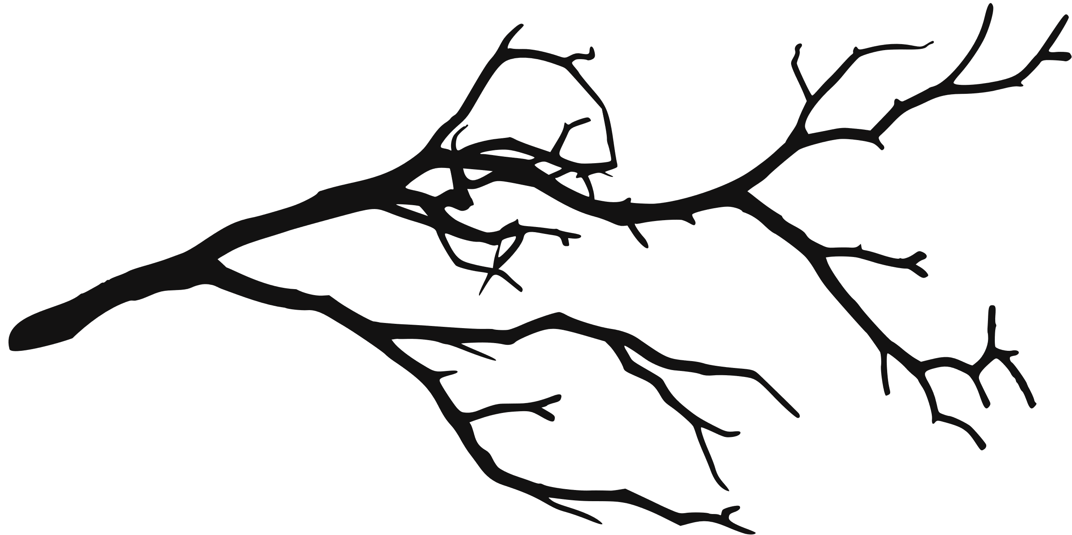

later nest initiation date
drier year
less food and resources available
owls have to stop more frequently during migration

Slide 14
Mexican Gray Wolf Recovery Program
      Cross-fostering is a coordinated effort of the U.S. Fish and Wildlife Service, Arizona Game and Fish Department, New Mexico Department of Game and Fish, Bureau of Land Management, New Mexico State Lands Office, U.S. Forest Service, and the Mexican Wolf Species Survival Plan
      In May 2022, 11 pups were released into wild populations
Gray Wolves and Climate Change

Slide 15
  There is a lack of research on how the specific subspecies, Canis lupus baileyi, will be affected by climate change
  Research was done on gray wolf denning phenology being affected by climate change in Alaska
    climate does not have a significant impact on successful breeding and surviving wolf pups
Gray Wolves and Climate Change
  Other research has found that prey can be negatively affected by climate change
  Wolf packs that need to travel for food during the summer were less successful in the numbers of pups that survived
  Found reduced reproductive success in hotter summers

Slide 16

Ongoing Research

Slide 17
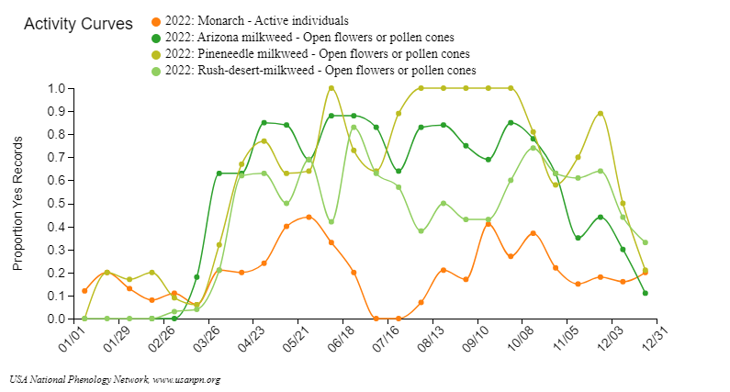
Monarchs and Milkweeds in Arizona

Slide 18
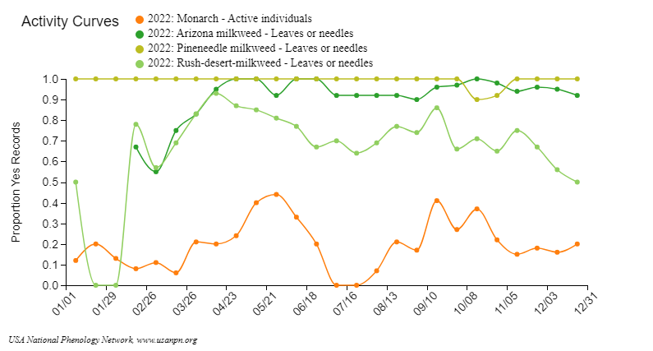
Monarchs and Milkweeds in Arizona

Slide 19
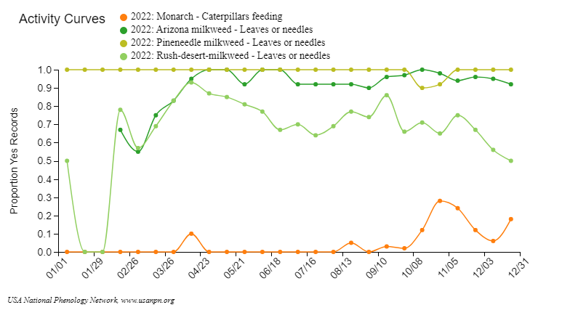
Monarchs and Milkweeds in Arizona

Slide 20
Climate Projections

Slide 21
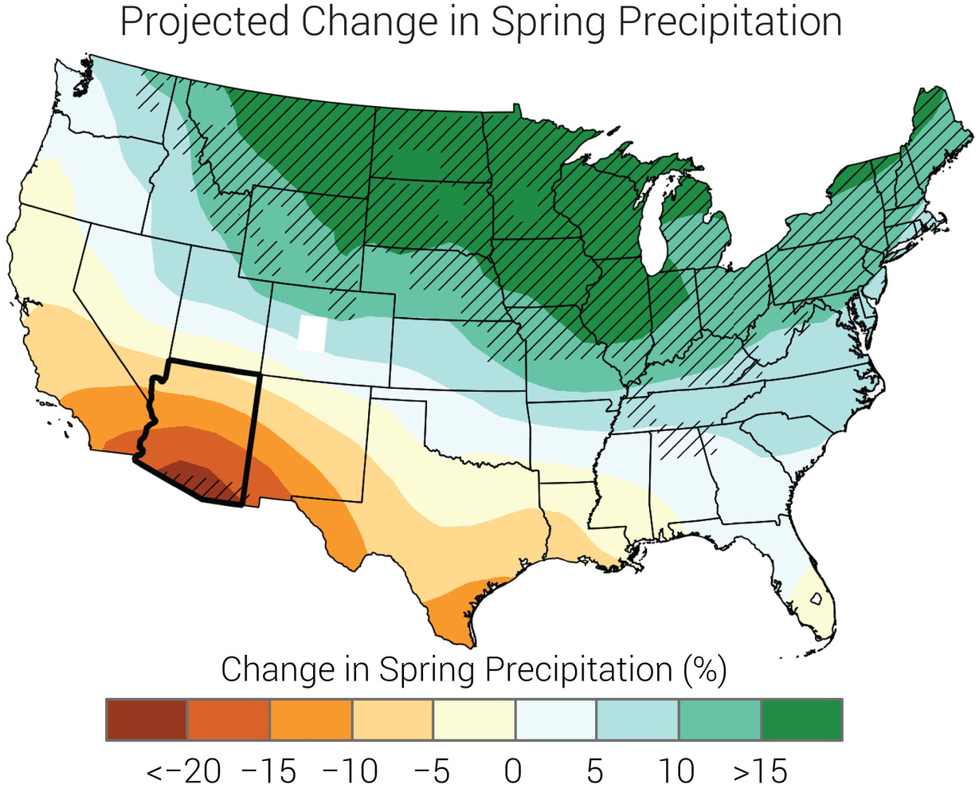

Slide 22
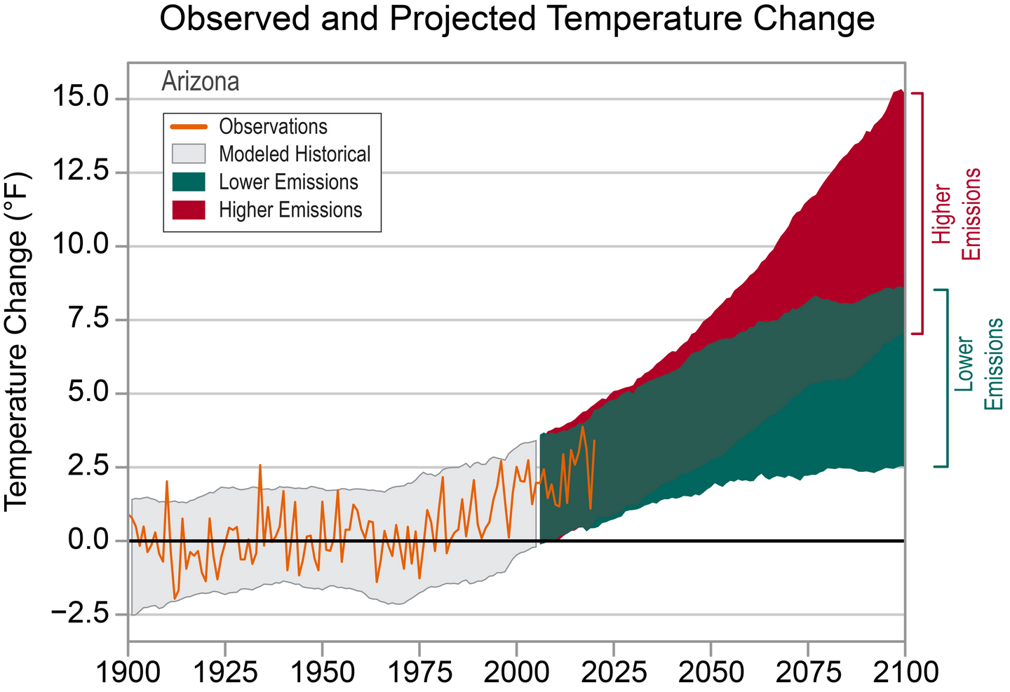

Slide 23
Thank You

